Slide 1


Data Governance @ SneakerPark
Prepared by: Arpit Sharma
Submitted on: 17-Jun-21

Slide 2
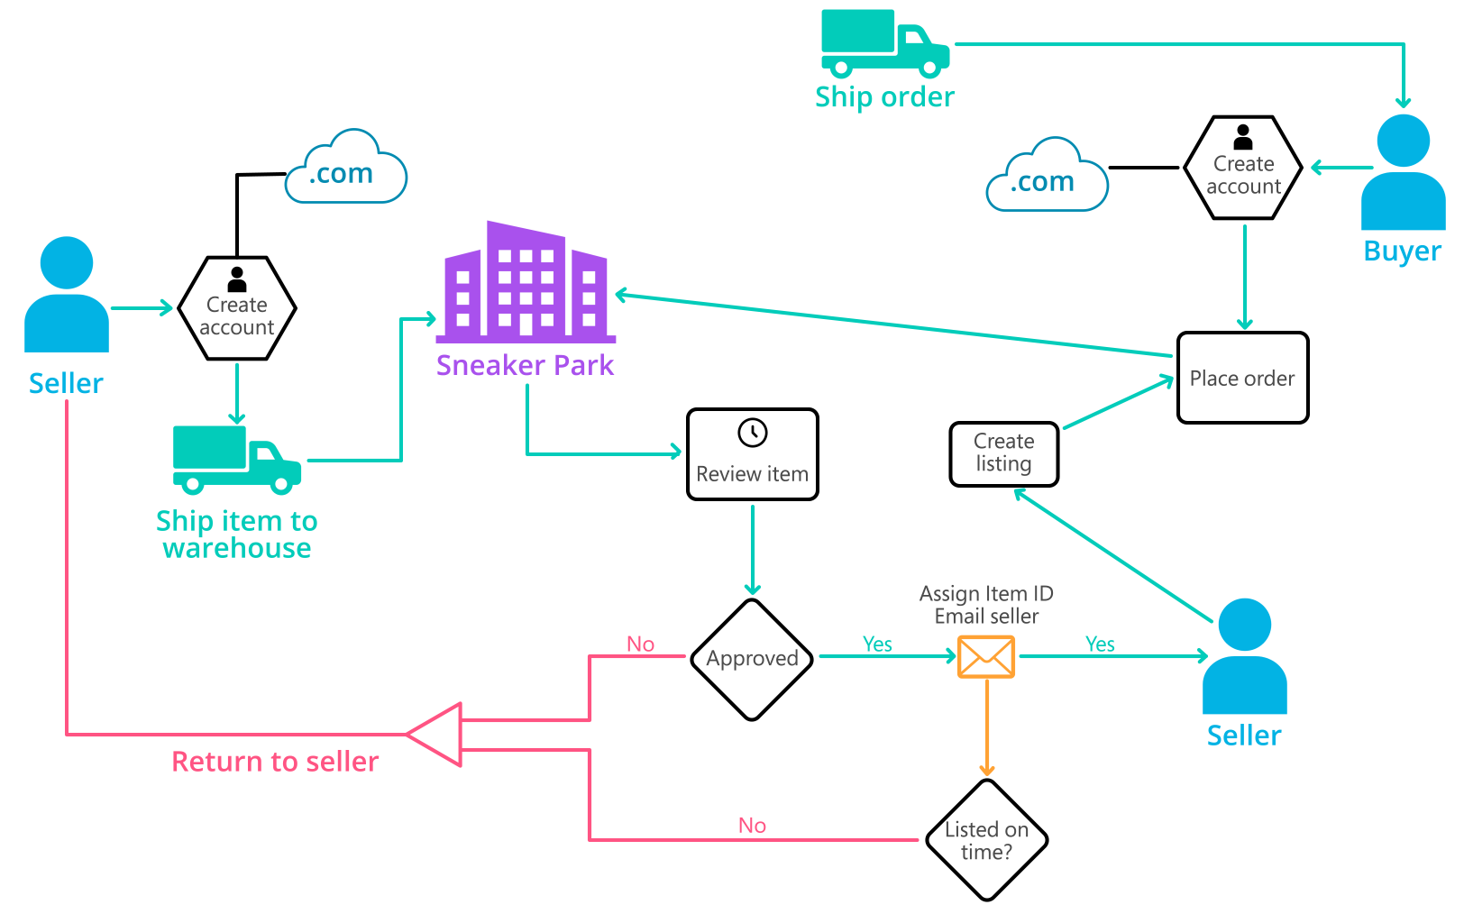
Background (cont’d)
Below you can see a diagram that will hopefully help you visualize some of SneakerPark's business processes. Keep in mind that it does not capture ALL processes and every nuance, but simply serves as another artifact to use in your project.

Slide 3
Step 1
Enterprise Data Catalog Part 1: Enterprise Data Model

Slide 4
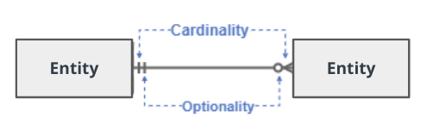
Create a conceptual data model that will provide SneakerPark with a holistic view of its data systems and help you grasp the organization's important entities and relationships, which will be instrumental as you move further in the project. You can use Lucidchart or any other diagramming tool of your choice, but please use the Crow’s Foot/IE Notation and please be sure to indicate both cardinality (the type of a relationship such as 1:N or N:N) and optionality (whether the relationship is optional or mandatory).

Slide 5
Replace the example below with your own solutions (obviously feel free to take more space):

Slide 6
Step 2
Enterprise Data Catalog Part 2: Metadata

Slide 7
Create the first version of the Metadata Catalog by documenting the metadata from all systems in the "Data Dictionary" and the “Enterprise Data Catalog” tabs of the provided Sheets template.
Please note that you are required to fill out all fields in both tabs.
Answer : Refer to the document “sneakerpark-final.xlsx” for filled template. It is attached with this submission .

Slide 8
Step 3
Data Quality
Part 1: Profiling and Cleansing

Slide 9
Profile the data to identify at least 3 data quality issues you see in the data. Also provide at least 1 data quality issue that you haven’t yet seen in the data, but can foresee occurring in the future. Based on the issues you’ve identified, come up with the data quality rule for each data quality issue, including for the one that you foresee.
Make sure you fill out all columns in the "Data Quality Issues" tab with your answers in the provided Sheets template.
Answer : Refer to the document “sneakerpark-final.xlsx” for filled template. It is attached with this submission .

Slide 10
Step 4
Data Quality
Part 2: Monitoring

Slide 11
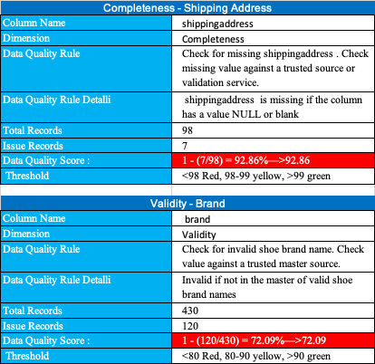
Using the metrics you've created in the last step, please create a mock-up of a data quality monitoring dashboard that will be used to monitor the data to ensure compliance with your data quality rules.

Slide 12
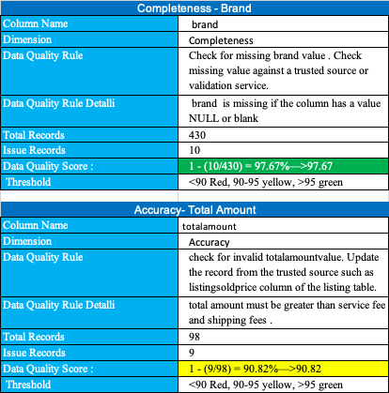
Using the metrics you've created in the last step, please create a mock-up of a data quality monitoring dashboard that will be used to monitor the data to ensure compliance with your data quality rules.

Slide 13
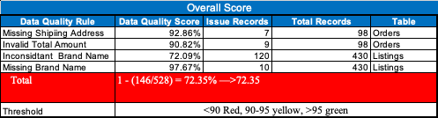
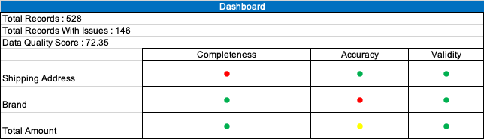
Using the metrics you've created in the last step, please create a mock-up of a data quality monitoring dashboard that will be used to monitor the data to ensure compliance with your data quality rules.

Slide 14
Step 5
Master Data Management
Part 1: MDM Architecture

Slide 15
Based on what you’ve read about SneakerPark’s systems and business model, sketch out a proposed MDM implementation architecture, and write a detailed explanation of why you chose this specific approach.

Slide 16
Explanation:
Sneaker Park is growing at a fast pace which resulted in increased number of sellers, buyers, items, and sales. As a result of this growth, sneaker park is running into discrepancies between systems which resulted in mischarges, lost revenue, and frustrated customers. The company is not able to keep track of their customers and Inventory data across different systems.
Besides this, sneaker has also decided to invest in an Enterprise Data Management program and eventually wants to build out an Enterprise Data Warehouse solution. So, considering this, it makes sense to go with centralized style of architecture.

Slide 17
Step 6
Master Data Management
Part 2: Master Record

Slide 18
In this step, you will define a set of matching rules that will be used by the SneakerPark's MDM Hub to match item and customer entities between the company's different systems.
Please come up with 4 rules - 2 for Items and 2 for Customers and list them below.
Customers :
Tables Users, customerservicerequests, creditcards share the userid identifier, while creditcards shares creditcardid with orders table. This means we can use the following two rules:
-Match customer data on userid.
-Match customer data on creditcardid.
Items :
Both tables Items and listing share the sellerid identifier, while order id shares listingid with orders table ( via orderitems table)
. This means we can use the following two rules:
-Match Items data on sellerid.
-Match Items data on listingid and orderid using orderitems and orders table .
Refer attached excel “Golden_Record_Exercise.xlsx”.

Slide 19
Step 7
Data Governance:
Roles and Responsibilities

Slide 20
Write 1-2 paragraphs discussing what data governance roles and responsibilities will be necessary to oversee this new Data Management initiative. Please be sure to discuss the responsibilities in the context of at least 3 different aspects of Data Governance (such as Data Quality Management, Metadata Management, MDM, etc). Based on what you know, do SneakerPark's current employees have the necessary skills for these roles or should the company make new hires?
Following data governance roles and responsibilities will be needed for this data management initiative.
1. Chief data officer - Supports the strategic data management board in defining a data management strategy and setting up a data governance
2. Business SME's (also called Business Subject Matter Experts) - are experts in their respective departments and provide you with business context for data definitions and business rules. Those experts help create business metadata.

Slide 21
3. Data Stewards
a. own the governance activities like review and approve metadata content provided by Business SMEs.
b. Measures and reports the data quality, documents the data in a data catalog / glossary. Also, receive notification on data quality issues alerts so that they can work on the research and remediation of these issues
c. Also, play plays a critical role in MDM implementation and performs following activities.
Define match rules for golden record creation.
Review match results
Approve or reject golden records
Override match results
Review rejected records
Manually create golden records.
4. Technical and IT Teams –
a. Technical developers and architects create technical and operational metadata and create automated processes to ingest existing metadata into the Metadata Management System
b. Sometimes, the data quality processes that calculate the scores or create reports and dashboards can fail. In the case of these failures, IT support is alerted so that they can fix this issue.
c. Once MDM is created ,these technical teams monitor processes that create the golden records and populate the MDM hub regularly (e.g., Nightly, weekly) basis.
Jake can perform the IT role and Jessica can perform the Data steward role to support the data governance initiative.

Slide 22
Standout Suggestions

Slide 23
Create a Business Glossary for SneakerPark and define common terms such as Item, Buyer, etc. Think and discuss how SneakerPark can improve on the consistency of the terms that its systems currently use. (You can use the “Business Glossary” tab of the same Sheets template you’ve been using for the other parts of this project to get you started.)
Document SneakerPark’s current naming conventions. Can you think of any improvements? (You can use the “Standard Naming Conventions” tab of the same Sheets template you’ve been using for the other parts of this project to get you started.) Some examples of Naming Conventions include;
Do not use spaces or special characters.
Use only LOWERCASE.
All identifier fields should end in “_id”.
Avoid acronyms and abbreviations.
Write SQL scripts for the matching rules that you’ve created in Step 6.

